Slide 1


By Calum Bain | Charles Thomas Merrick Bisset | Lee Sturrock

Slide 2

GAME IDEA AND OVERVIEW
Hi-Jack is a first-person, arena, shooter where the players must fight and survive waves of robot enemies that spawn at an increasingly aggressive rate as the waves/rounds progress. The player has a multitude of weapons to defend themselves.
The target audience for this game anyone of the age 12+ that has a small amount of background experience with first person shooters and is a fan of science fiction or the 80s/Tron aesthetic.
Notes:
Charles

Slide 3


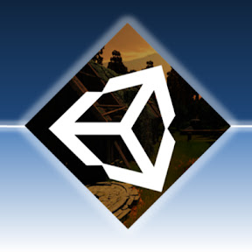
GAME ENGINE CHOICE
Unity was the engine choice for our game as it is very object oriented, and as all of our team came from a software development background it felt quite natural to get the hang of. Another plus was that unity has a lot of community tutorial sources and a thriving YouTube community dedicated to teaching you new and interesting ways to use the engine, which helped all of us greatly as none of us had ever tried to make a game before.
Tutorial making channels such as “Brackeys” helped us get a lot of our fundamental gameplay elements up and running smoothly, as well as “Jimmy Vegas” who helped us get a basic understanding of the Unity UI and tools.
Notes:
Lee

Slide 4

GAME ENGINE CHOICE (cont)
We also considered using Unreal engine as we had heard it was more tailored to our sort of game more, however we decided against this as the primary (if not the only) language was C++, and none of us fancied delving into a programming language we weren’t too familiar with. Some team members also found the user interface of Unreal engine quite intimidating in comparison to Unity’s so we ultimately ended up choosing Unity in the end.
Notes:
Charles

Slide 5
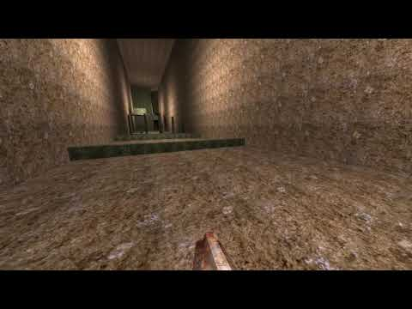
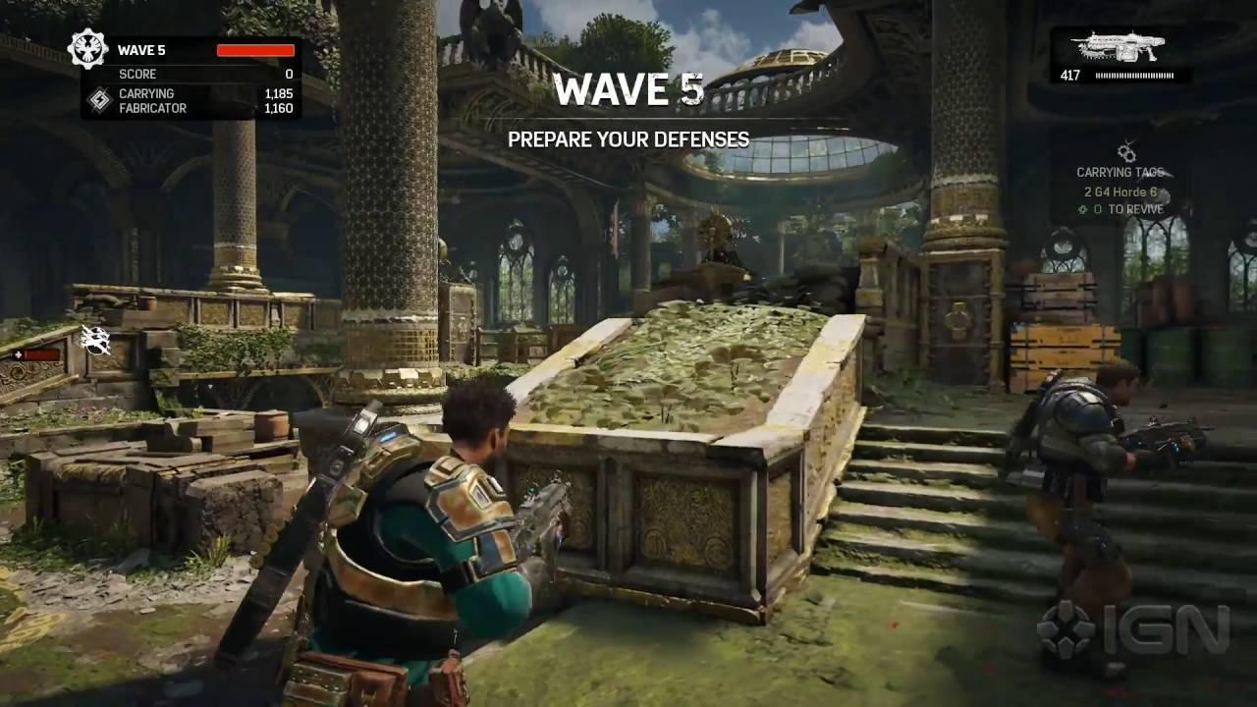
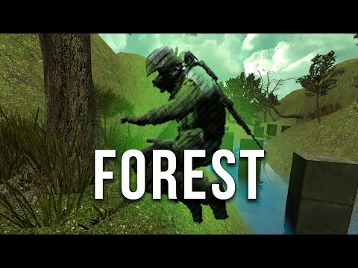
GAMEPLAY AND MECHANICS
Skill-based first person shooting.
Quake/Source inspired movement system.
Weapon progression.
Wave based scaling difficulty.
Points are awarded on successful enemy kills.
Inherent difficulty scaling.
Once your health reaches zero it’s game over.
Notes:
Lee

Slide 6

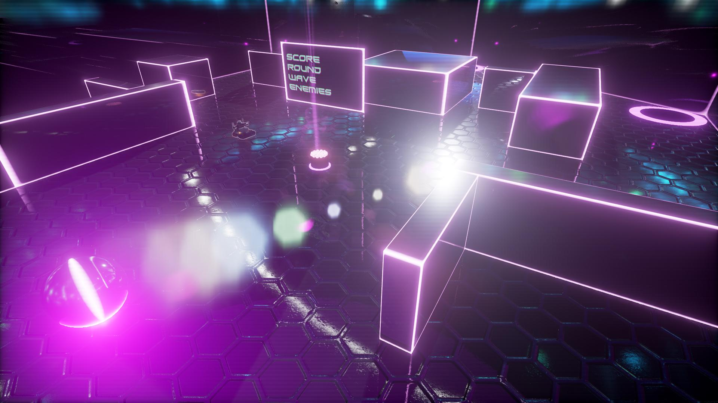
LEVEL DESIGN & 3D MODELLING
In the game’s universe you are inside one of many simulations fighting increasingly difficult hordes of robotic enemies
The aesthetic is heavily inspired by Tron and 80’s pop culture with its neon lights, sleek surfaces and basic geometric shapes
All models made in Maya
Glowing materials couldn’t transfer to Unity
Re-made Materials, Lighting and Animations were made in Unity
Notes:
Calum

Slide 7
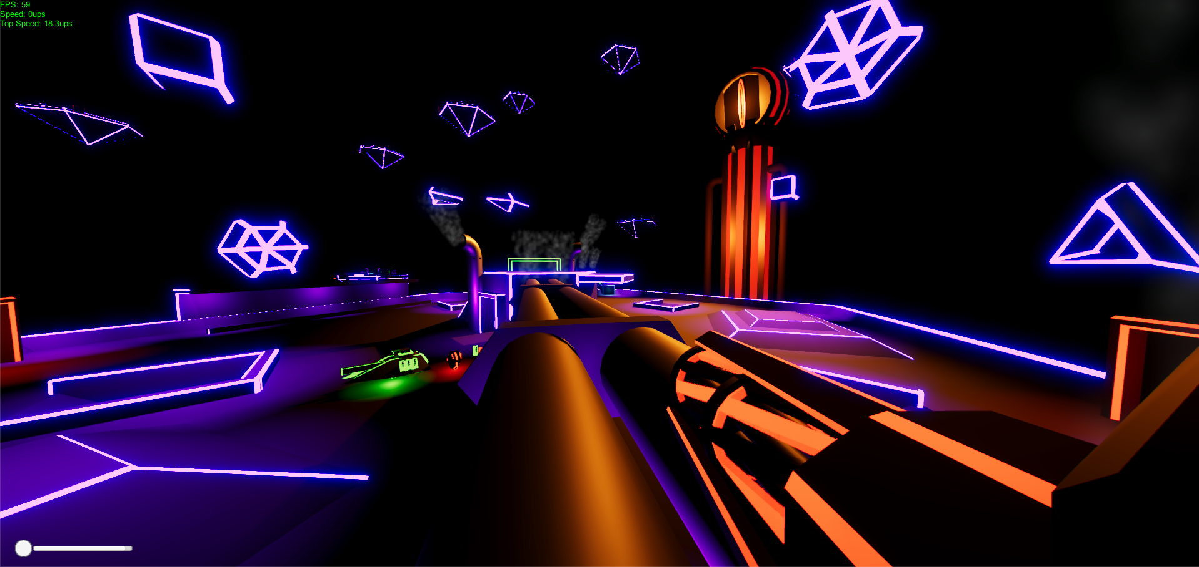
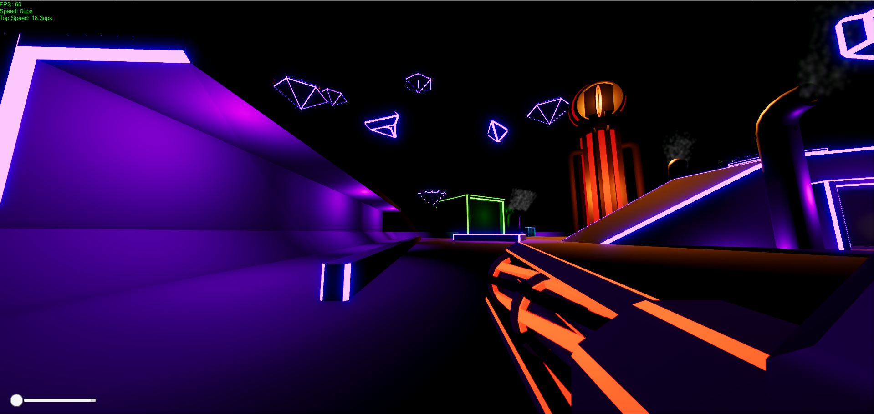
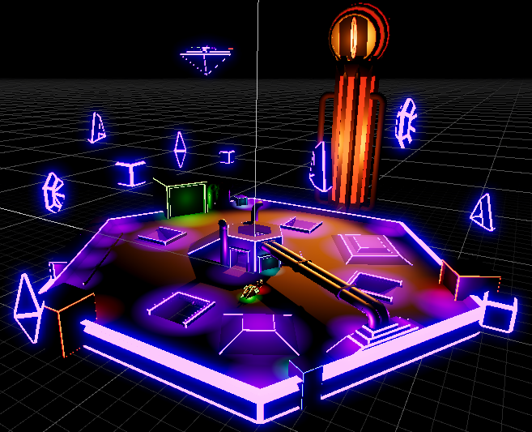
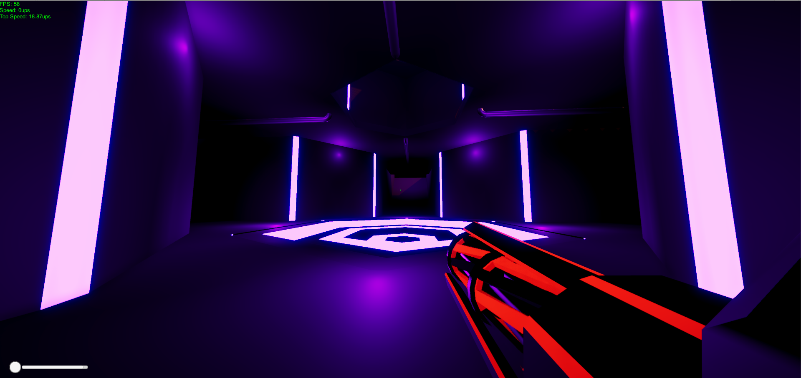
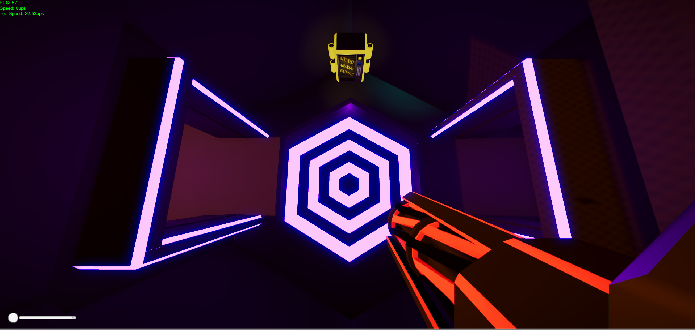
COMBAT ARENA
Notes:
Calum

Slide 8
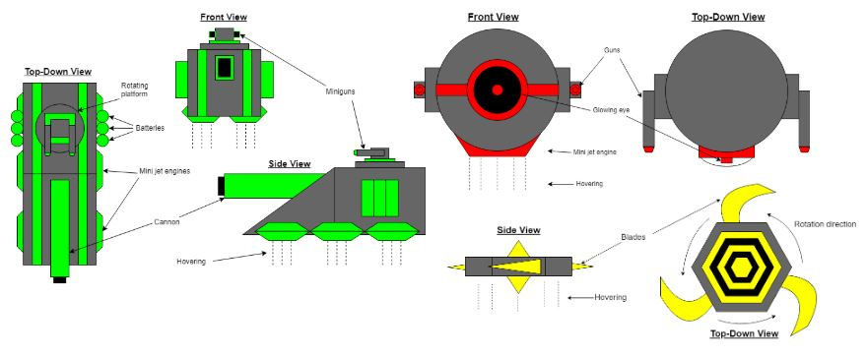
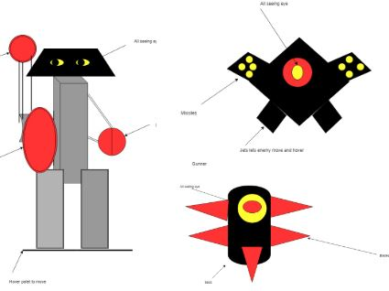
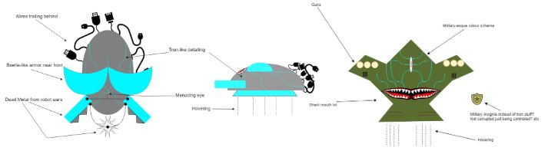
ENEMIES - CONCEPT ART
Early concepts of a Melee, Shooter and Tank enemy
Notes:
Calum

Slide 9
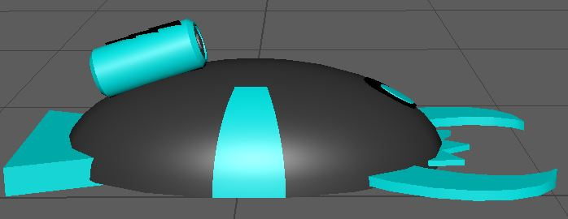
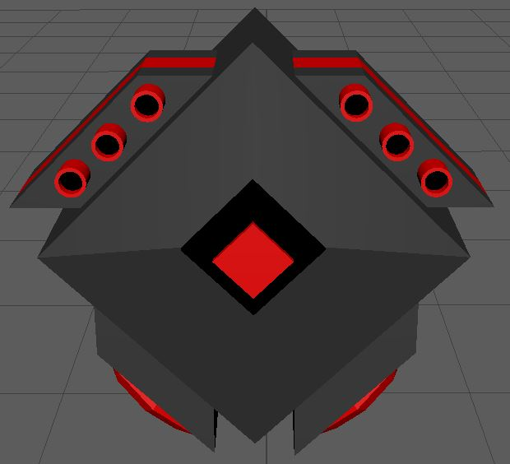
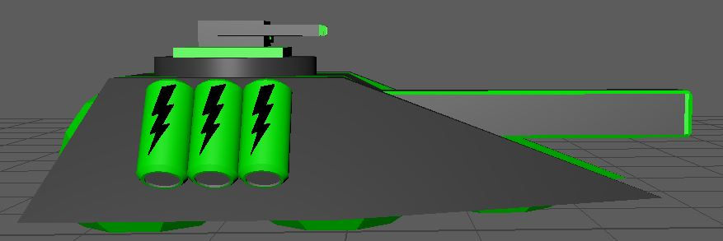
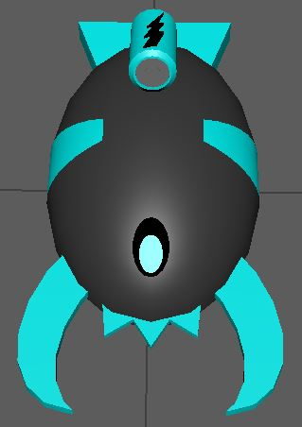
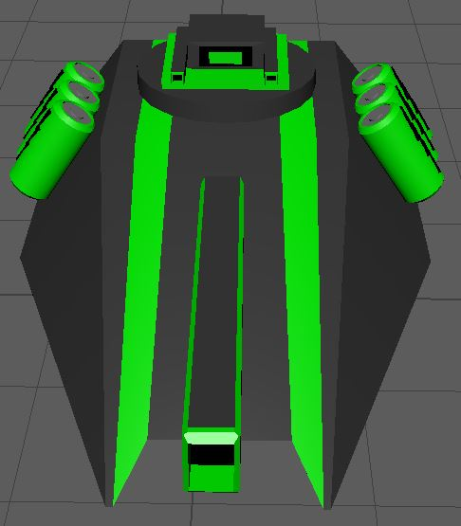
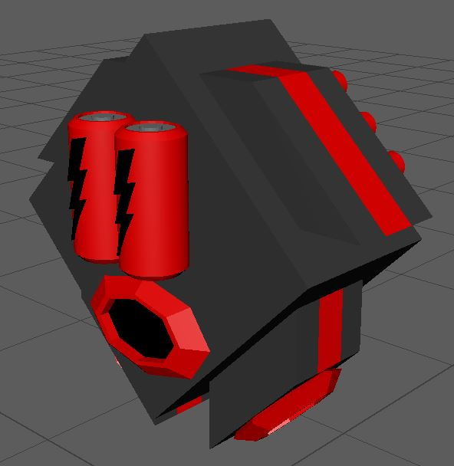
ENEMIES - FINAL DESIGN
Phish - Melee
Scrubber - Shooter
Trojan - Tank/Brute
Notes:
Calum

Slide 10
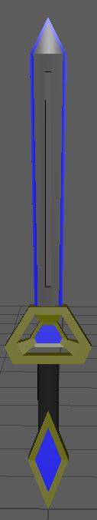
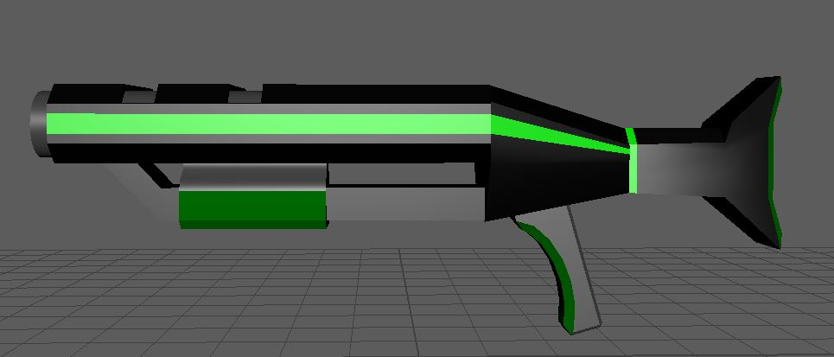
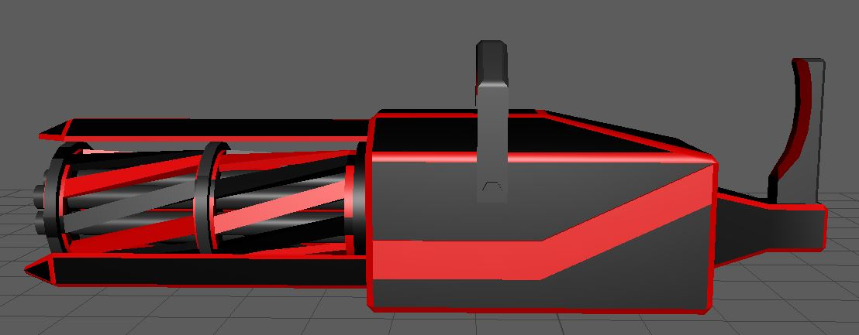
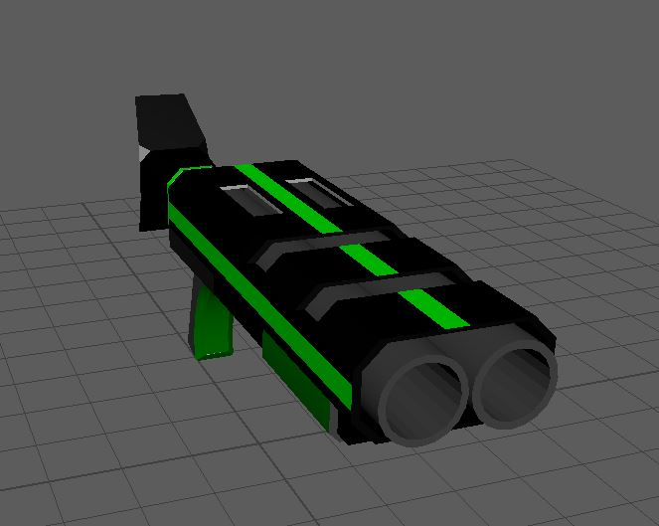
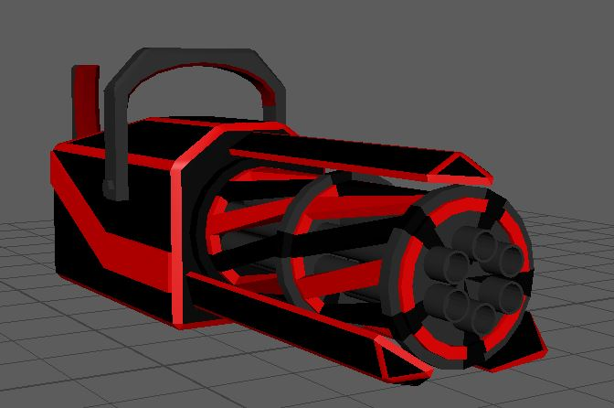
WEAPON MODELS
Shotgun - High Damage, Short Range
Machine Gun - Low Damage, Long Range
Sword - Average Damage,
Very Short Range
Notes:
Calum

Slide 11
ANIMATIONS
Animation and Scenery is important in Immersfying the player into the world you have created
Similar process to creating animations Maya
Animations completed so far
Main and Miniature lift
Phish’s claws
Sword swing, Machine gun spinning, Shotgun Recoil
Floating geometry
Menu J.A.C.K loop
Floating arenas
Animations still to be completed for the final build
J.A.C.K looking around the arena in game
Revolver, Rocket Launcher and Gauss Cannon recoil
Trojan’s Turret
Enemy destroyed/killed
Notes:
Calum

Slide 12
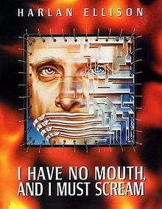
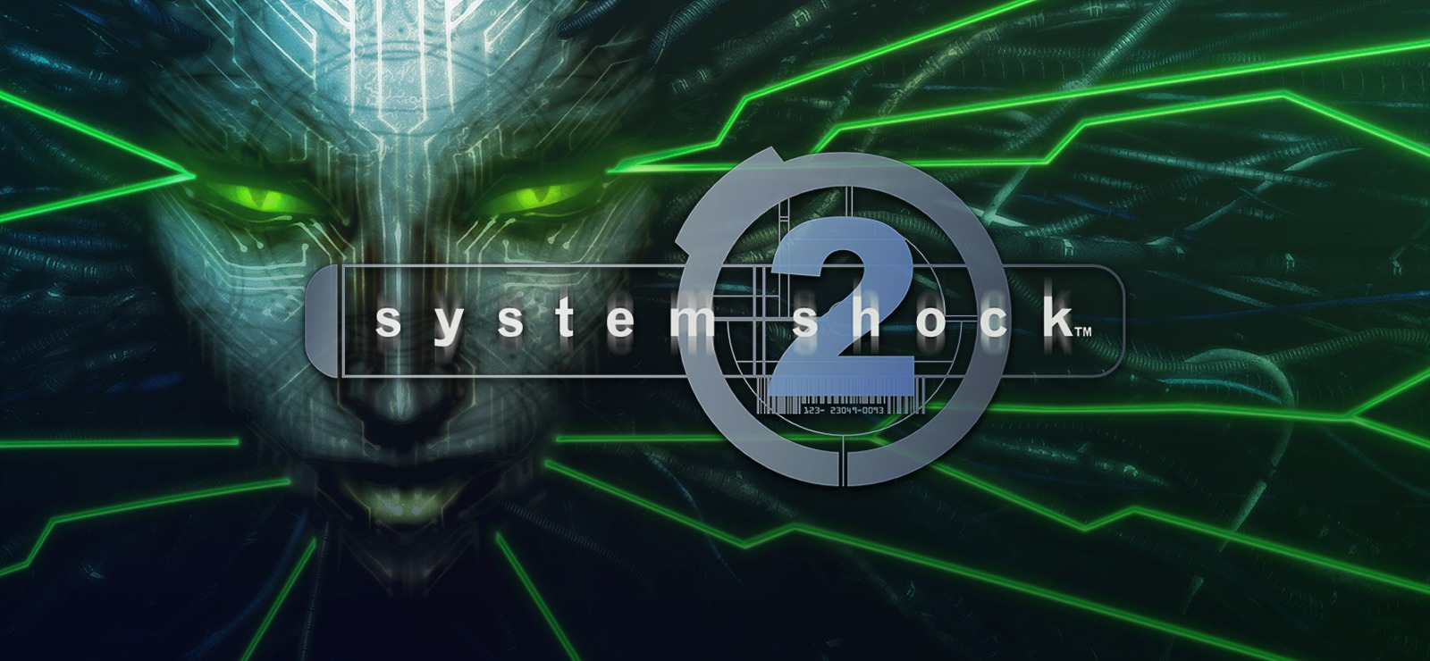
BACKSTORY & LORE
Game has a considerable backstory, featuring some world building and an antagonist.
The world is portrayed as a post-apocalyptic future, ripped apart by war and overruled by a super-computer called J.A.C.K
J.A.C.K isn’t satisfied with just ruining the physical world it lives in, and to quench this satisfaction, J.A.C.K runs thousands upon thousands of simulations in which it re-creates humanity's destruction over and over again.
The resistance of this ruined world are about to launch an assault on J.A.C.K as they believe if they are able to assimilate someone from the physical world into one of J.A.C.K’s simulations it will cause corruption to set in and allow the resistance to gain control of J.A.C.K’s systems.
To achieve this goal they turn to … The Hackermen.
Notes:
Lee

Slide 13
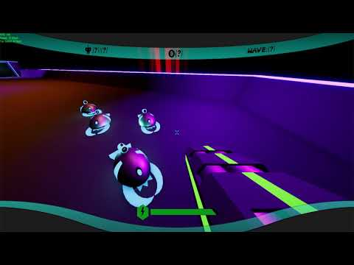
GAME IMPLEMENTATION
Notes:
All of us (?)

